Slide 1

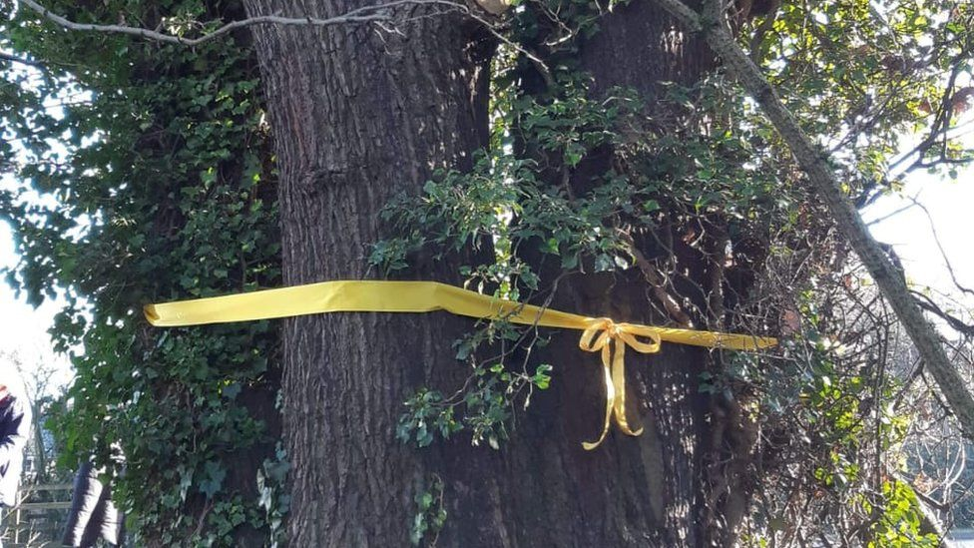
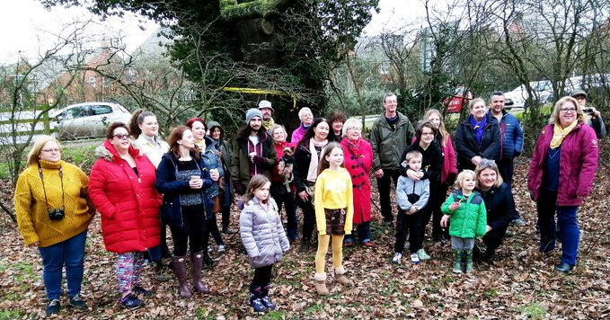

Read the poem:
How does this make you feel about environmental protest?

Slide 2


How can stories inspire climate action?
How can stories inspire climate action?
Success Criteria - I can:
- Describe examples of religious and non-religious climate activists.
- Reflect on how these can inspire others to action.
Key Terms
Activist
Protest
Climate Justice
Inspiration

Slide 3
How can stories inspire climate action?
Read through your story.
Write down your responses to these questions (be ready to share them with the class):
What do you think inspired your person to take action?
What have they done to fight for climate justice?
Which quote from them do you find most inspiring?
Success Criteria - I can:
- Describe examples of religious and non-religious climate activists.
- Reflect on how these can inspire others to action.
Key Terms
Activist
Protest
Climate Justice
Inspiration

Slide 4
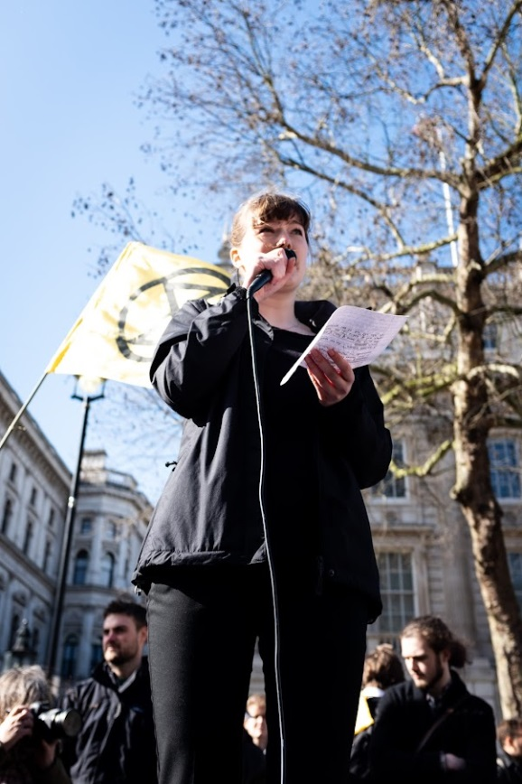
How can stories inspire climate action?
Rachel Mander
Success Criteria - I can:
- Describe examples of religious and non-religious climate activists.
- Reflect on how these can inspire others to action.
Key Terms
Activist
Protest
Climate Justice
Inspiration

Slide 5
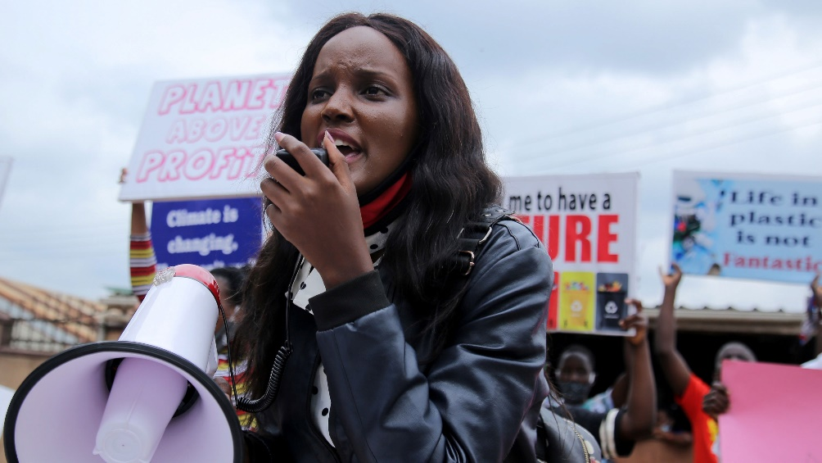
How can stories inspire climate action?
Vanessa Nakate
Success Criteria - I can:
- Describe examples of religious and non-religious climate activists.
- Reflect on how these can inspire others to action.
Key Terms
Activist
Protest
Climate Justice
Inspiration

Slide 6
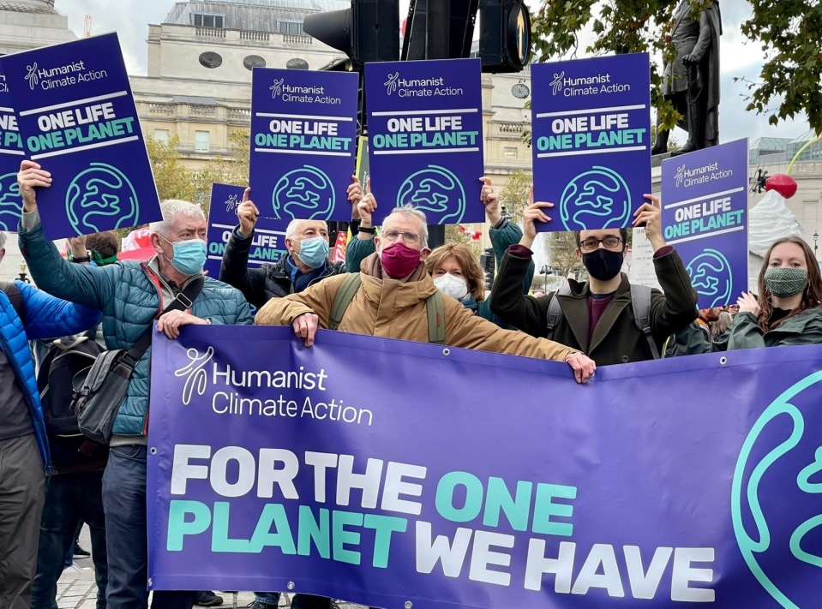
How can stories inspire climate action?
Lori Marriott
Success Criteria - I can:
- Describe examples of religious and non-religious climate activists.
- Reflect on how these can inspire others to action.
Key Terms
Activist
Protest
Climate Justice
Inspiration

Slide 7

How can stories inspire climate action?
Zach Haynes
Success Criteria - I can:
- Describe examples of religious and non-religious climate activists.
- Reflect on how these can inspire others to action.
Key Terms
Activist
Protest
Climate Justice
Inspiration

Slide 8
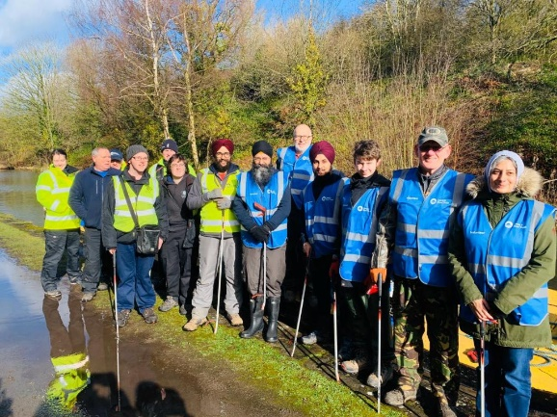
How can stories inspire climate action?
Dr. Hardeep Singh
Success Criteria - I can:
- Describe examples of religious and non-religious climate activists.
- Reflect on how these can inspire others to action.
Key Terms
Activist
Protest
Climate Justice
Inspiration

Slide 9
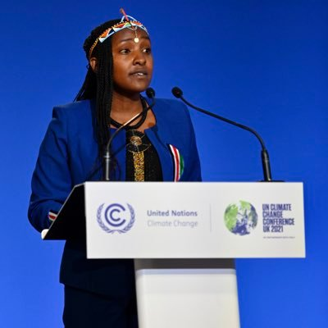
How can stories inspire climate action?
Elizabeth Wathuti
Success Criteria - I can:
- Describe examples of religious and non-religious climate activists.
- Reflect on how these can inspire others to action.
Key Terms
Activist
Protest
Climate Justice
Inspiration

Slide 10
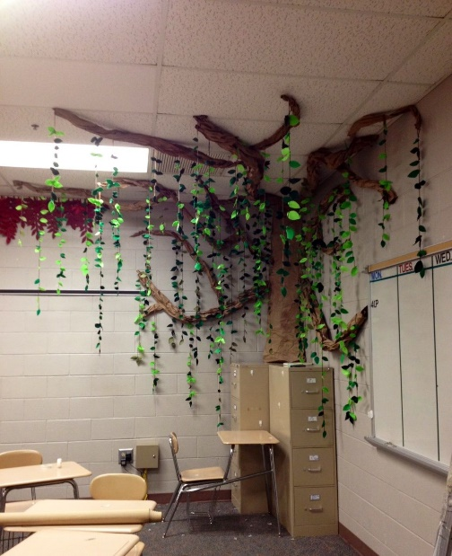
How can stories inspire climate action?
We are going to create a tree of inspiring stories:
On one side of your leaf write:
- a brief description of your climate activist
- a quote from them about why they try to fight climate change
On the other side of your leaf write:
How this person inspires you
Something you might do yourself to act on climate change
Success Criteria - I can:
- Describe examples of religious and non-religious climate activists.
- Reflect on how these can inspire others to action.
Key Terms
Activist
Protest
Climate Justice
Inspiration

